Slide 1


Effective Learning
Goldrick, M (2008)
Unit 2: Effective Study strategies and resources

Slide 2

General Time Management
There are specific time-related strategies each of us can develop when working;
Prioritize: Try to get assignments with upcoming deadlines processed early to free things up for exam revision.
Using “Lost time”: bus and train commutes can be useful for reading/listening to course material!
Be kind to your body: work regularly in bursts rather than “cramming” all night writing or studying.

Slide 3
Creating your own study-table
Some students find it helpful to create a weekly planner to outline what they intend to study in the upcoming week.
 | Mon | Tues | Wed | Thurs | Fri | Sat | Sun
8-9 | Bus study | Bus study | Bus study | Bus study | Bus study | Foot ball | rest
9-10 | Econ | Math | Law | project | Comp | OFF | OFF
10-11 | Infosys | essay | Econ | Comp | project | OFF | OFF
*Try to be specific in your timetable

Slide 4
Some General Study Tips
Try to find a place where you are comfortable studying in, whether this is at home or in the library.
Try and Keep to your study-table, the more you try the easier it will become.
Break down longer assignments into smaller sections, e.g. planning, research, writing, proofing

Slide 5

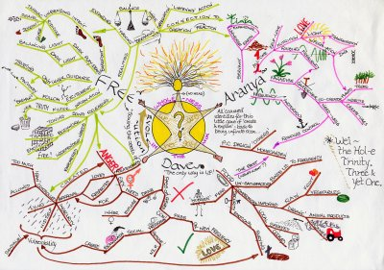
For those students who prefer more visual learning, the usage of a mind-map can help increase attention and recall of information

Slide 6
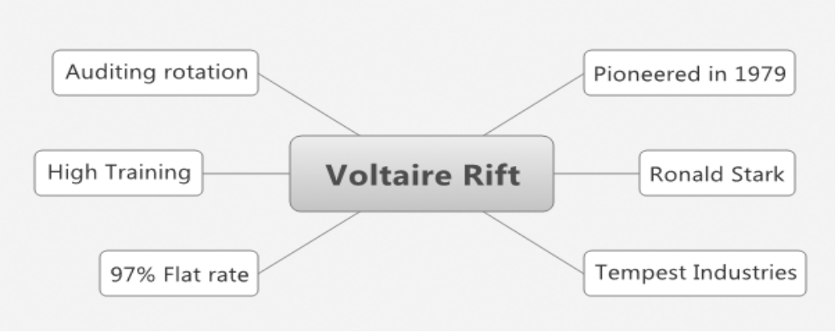
Some mind mapping programs
xmind | http://sourceforge.net/project/platformdownload.php?group_id=246829 or http://www.xmind.net/ | Freeware
FreeMind | http://freemind.sourceforge.net/wiki/index.php/Download | Freeware

Slide 7



For students who may learn best through aural forms, there are some free tools through which you can create an mp3 version of your notes.....
Email a Word or Pdf document to: britspeech@robobraille.org

Slide 8
Taking notes in a Lecture
Make sure to have a folder or binder for your notes
Try to read assigned material before each class
Don’t try to write everything down use abbreviations
Education
Ed
curriculum
Curr

Slide 9
The Cornell Method
Topic
Description
The role of the manager
Accord to Wilcox (1993) the role of the mangr is to be an effective strategic leader.
Accord = according,
Mangr = manager

Slide 10
Bibliography
Drew, S. and Bingham, R. (2001), The Student Skills Guide, 2nd ed., Aldershot, Gower.
Moran, Aidan. P. (1997) Managing Your Own Learning at University; A practical guide; University College Dublin Press, Dublin. (371.3)

